Slide 1
Introduction to the Stoppit-3 study
Dr Sarah Murray
Co-Chief Investigator
Subspecialty Trainee in Maternal and Fetal Medicine and Clinical Lecturer at the University of Edinburgh
This study is funded by the National Institute for Health Research (NIHR) Health Technology Assessment Programme. The views expressed are those of the author(s) and not necessarily those of the NIHR or the Department of Health and Social Care.

Slide 2
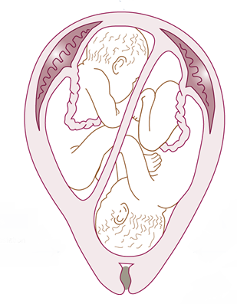
Overview
Background/aims of the trial
Where we are currently
Common queries from sites

Slide 3
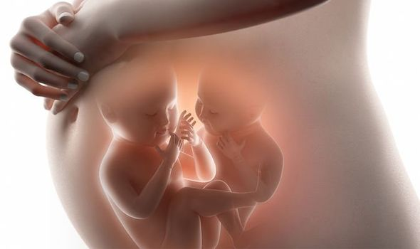
Background
Aim: to assess the effectiveness of antenatal corticosteroids (ACS) prior to planned birth in twins
Setting: multi-centre placebo controlled trial with internal pilot
Rationale: lack of evidence of the use of ACS in twins

Slide 4
Background
Huge variation in clinical practice
Benefits ACS: reduce respiratory morbidity and neonatal unit admission
Harms of ACS: neonatal hypoglycaemia, reduction in fetal growth, possible detrimental effect on neurodevelopment

Slide 5
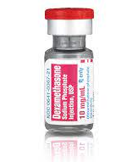
PICO
Population: Pregnant women with twins and planned birth 35-38+6 weeks
Intervention: two doses of 12mg dexamethasone by intramuscular injection 24 hours (+/- 4 hours) apart given within 7 days of planned birth
Control: two doses of matching placebo (0.9% NACL) by intramuscular injection 24 hours (+/- 4 hours) apart given within 7 days of planned birth
Outcome: need for respiratory support within 72 hours of birth

Slide 6
Primary Outcome
Composite of respiratory support within 72 hours of birth consisting of one or more of the following
continuous positive airway pressure (CPAP)
supplemental oxygen by high-flow nasal cannulae for at least 2 consecutive hours
need for supplemental oxygen by low flow nasal cannulae or incubator oxygen for at least 4 continuous hours
mechanical ventilation
Extracorporeal Membrane Oxygenation (ECMO)
Stillbirth
Neonatal death within 72 hours of birth

Slide 7
Secondary outcomes
To determine the effect of ACS on
Severe respiratory morbidity
Perinatal morbidity
Perinatal mortality
Maternal outcomes
Determine the cost effectiveness of ACS
Effect of ACS on cognitive and language development

Slide 8
Inclusion Criteria
1552 women
>16 years
Viable twin pregnancy with a planned birth
Known chorionicity
At least 24 hrs to delivery to allow study drug administration

Slide 9
Exclusion Criteria
Known fetal anomaly
Diabetes (pre-existing or gestational)
Women who have had steroids 7 days previously
Contraindication to steroids
Unknown chorionicity/gestational age
Serious pregnancy morbidity indicating birth before 35 weeks or <24 hrs

Slide 10
Timelines
Grant set up started Nov 2021
First site open: Aug 2022
10 month pilot aiming for 169 women and 36 sites open
Recruitment target of 1.1woman per month per site

Slide 11
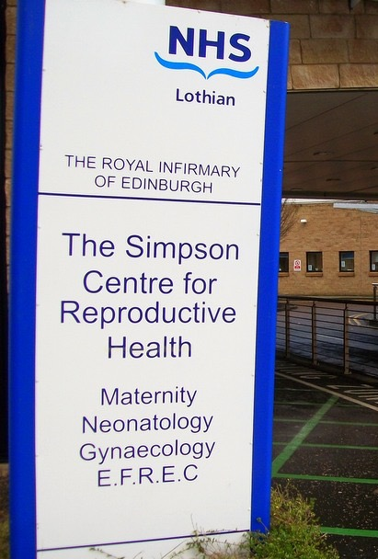
Where we are currently
2 sites open
Royal Infirmary Edinburgh
Chesterfield

Slide 12
Where we are currently
7 sites awaiting final paperwork sign off
Royal Devon
Somerset
Leeds
East Lancashire
Birmingham Women’s Hospital
North Tyneside Hospital
South Tees

Slide 13
Common queries from sites
Email the trial team with any questions/queries
Examples of recent queries
Co-enrolment in other trials
Delivery of 24 hour unblinding
Discharge <72 hours and how to complete data collection

Slide 14
Thank you for coming and supporting STOPPIT-3

